Slide 1
Rehoming probability of reptiles and amphibians based on needs
By Conrad Hammond
Aim of my research
Earlier in the COPE course I planned and created a questionnaire to figure out why people would rehome reptiles and amphibians based on their needs and habitat requirements. The reason I wanted to research this topic or problem is because I wanted to find out how often “beginner” level reptiles are bought and rehomed because they are too difficult over the more expensive “easier” ones.
This presentation will highlight and analyse my results and feedback using secondary data from other sources found on the internet.

Slide 2
Secondary findings from NCRW website
I notice that more samples were taken every year.
From 2019 to 2021 the percentage of animals rescued increased, but dipped slightly in 2022.
Perhaps this means that the effects of Covid could have been a big factor in the increase of rehoming rates.
From 2018 to 2020 (Covid year) the rescued animals went from 7% to 19% in just two years.
However, the rate of rehoming decreased every year from 2018 to 2022.

Slide 3
Hypothesis
I hypothesise that, based on the Google searches made, more people are interested in looking after more beginner friendly reptiles, so these will be more likely be rescued or rehomed, as there are more of them. For example the Bearded Dragon brought up more searches than the less well known lizard, the Black and White Tegu. The Bearded Dragon is sold as an easy to look after first reptile and although it may seem so in the beginning, people may buy these for children who may lose interest in these animals and therefore need to be rehomed.

Slide 4
Method
I created a questionnaire on MS Forms for people to answer 9 questions. The questions were based on rehoming, care difficulty and reasons for rehoming.
The majority of my 13 respondents were reptile or amphibian owners; this helped with the questionnaire in terms of how well they know the topic.
I used Convenience Sampling (people who could easily complete my survey) and this was done anonymously.
I analysed the data in Microsoft Excel to collect results and create charts.
I presented my findings in MS Power Point.

Slide 5
Results
1 Which species are hardest to maintain?
2 Which is most likely to be rehomed?
3 Which habitat is hardest to recreate?
4 What are the barriers to rehoming?
5 Descriptive responses analysis

Slide 6
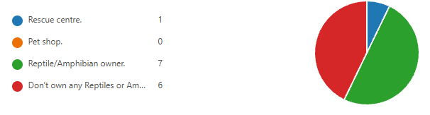
Which species are hardest to maintain?
After asking whether participants were reptile or amphibian owners, I asked which reptile or amphibian they thought was hardest or easiest to maintain. The results are as follows: -
What part of the reptile community are they.
While I have taken the results at face value, some could have misinterpreted the requested order of difficulty, this could lead to some anomalous results.
The hardest species to maintain appear to be the ones with the most specific needs.

Slide 7
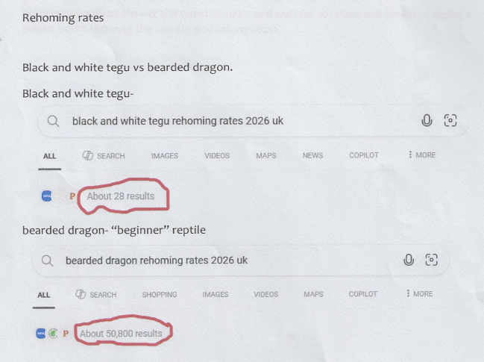
Which is most likely to be rehomed?
Next, I asked participants which reptile or amphibian they would most likely rehome (buy from a rehoming centre). The following slides will examine the reasons why. The results are as follows: -
Again, I have taken the results at face value, but it appears that some participants interpreted “rehoming” as getting rid of an animal rather than buying one.
From these results I can see the bearded dragon and the axolotl are most likely to be rehomed, and the green iguana and the cane toad are least likely to be rehomed. This infers that the larger species are less likely to be rehomed than smaller ones.

Slide 8
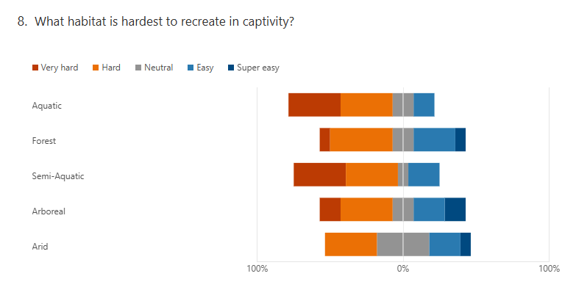
Which habitat is hardest to recreate?
Next, I asked participants which habitat they felt would be the hardest or easiest to recreate. The results are as follows: -
Following the results we can see that participants feel that environments that include bodies of water, such as semi-aquatic or fully aquatic, are more difficult to recreate in captivity.
On the other hand, many participants think that arboreal and forest habitats are easier to recreate in captivity, although still with a large percentage of participants finding them hard to recreate.
It could be argued that arid environments are the easiest to recreate at home, with the lowest number of votes for the hard or very hard category.

Slide 9
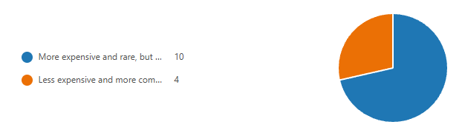
What are the barriers to rehoming?
Finally, I asked participants whether they would prefer to rehome an expensive species, with easier and cheaper care, or a less expensive species with more difficult and costly care. The results are as follows: -
What reptile respondents would prefer
Most participants felt that they would prefer to rehome a more expensive species which requires lower ongoing cost than a less expensive/more care cost species.
This suggests that people are more concerned about the ongoing cost of care over the initial costs of purchasing the animal.
29%
71%
Individual comments: -
A lot of the participants mention the cost of keeping the animal is a huge factor when deciding to rehome. Some mention the costs of electricity; others worry about the complexity of care. A small number worry about the animals becoming larger than expected or simply becoming bored of looking after them. Some people mention changes in life circumstances such as having to move house, losing a job or ill health. Overall, most people mentioned cost of living and lack of experience.

Slide 10
Evaluating Qualitative Responses i.e.
Complex descriptive text responses were categorised into 6 main recurring reasons why people surrender/rehome their pet reptiles.
Most people thought that the cost of the animal + equipment was a large factor in rehoming.
While only a small amount believed that space, size, time and interest were a big factor.
This suggests that because of current market trends perhaps things are difficult to purchase right now and people may not be willing to make a large investment and keep it.

Slide 11
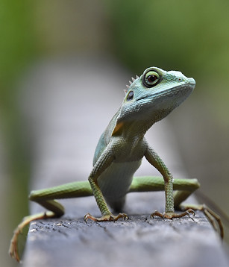
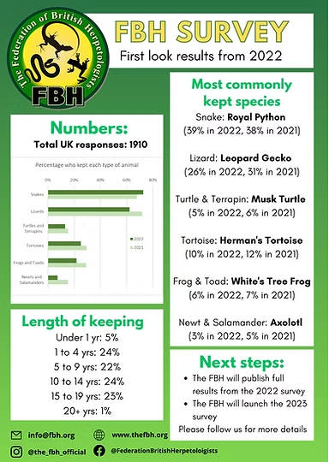
Summary of the research
In conclusion many participants would prefer a reptile or amphibian that's more expensive but easier to care for over time. This shows that participants care about the reptile or amphibian’s wellbeing because participants are willing to spend money to make sure care is easier. Overall, this suggests that participants want their reptiles or amphibians to have a fulfilling life while also ensuring participants can provide the right care.
Some links used: -
https://www.ncrw.org.uk/data
I checked the data from over the years to see rehoming rates vs death rates, on their public charts, which once again may be out of date.
(plus, the National Centre for Reptile Welfare website in general)
And Google RESULTS for some results shown on slide 3.
https://rspcabrightonreptilerescue.org.uk/adopt-a-reptile/
https://www.thefbh.org/survey
This gives info about the most kept reptiles and amphibians, while this could be a great site, it hasn't been kept up to date, allowing for false information in recent years where the economic climate may have taken a toll.
There was an error in my first QR code sent out to participants, which led to a delay in results coming in because it couldn’t be completed as it was private. That's why Links must be checked before being sent to participants.

Slide 12
Questionnaire summary (raw data)
5-green iguana hardest to maintain
4-chameleon hardest to maintain
2-tegu hardest to maintain
2-bearded dragon hardest to maintain
6-bearded dragon easiest to maintain
6-leopard gecko easiest to maintain
1-green iguana easiest to maintain
4-leopard gecko most likely to rehome
5-bearded dragon most likely to rehome
2-green iguana most likely to rehome
1-chameleon most likely to rehome
1-tegu most likely to rehome
4-axolotl hardest to maintain
3-pacman frog hardest to maintain
3s-bullfrog,firebelly hardest to maintain
1-cane toad hardest to maintain
5-axolotls easiest to maintain
3s-canes and pacman easiest to maintain
2-bullfrog easiest to maintain
6-axolotl most likely to rehome
3-pacman most likely to rehome
2-cane toad most likely to rehome
2-firebelly toads most likely to rehome

Slide 13
Questionnaire summary
Aquatic:
9- very hard/hard to recreate
2-easy to recreate
Forest:
7-very hard/hard to recreate
4-super easy/easy to recreate
Semi-aquatic:
10-hard/very hard to recreate
2-easy to recreate
Arboreal:
6- hard/very hard to recreate
5- easy/super easy to recreate
Arid:
4- hard to recreate
4- easy/super easy to recreate
6 people said they would prefer more expensive but easier care
4 people said they would prefer less expensive but harder to care
Overall, the majority of people would rehome because of cost, care and commitment

