Slide 1
Can a man-made wildlife habitat provide an Ecosystem for reptiles, amphibians and other wildlife to live in?

Slide 2
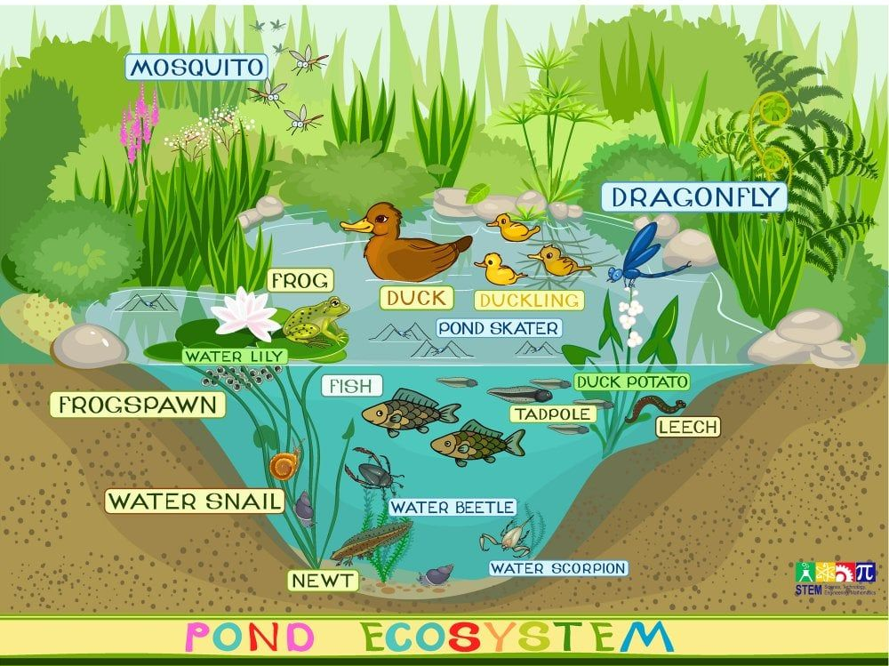
Pond Ecosystem
A pond ecosystem is a small-scale, self-contained freshwater environment where biotic organisms interact with their abiotic surroundings like water, sunlight, temperature and nutrients.
Within a pond there are different zones, from the pond surface at the top, down to the bottom of the pond, each zone has distinct inhabitants and functions.

Slide 3
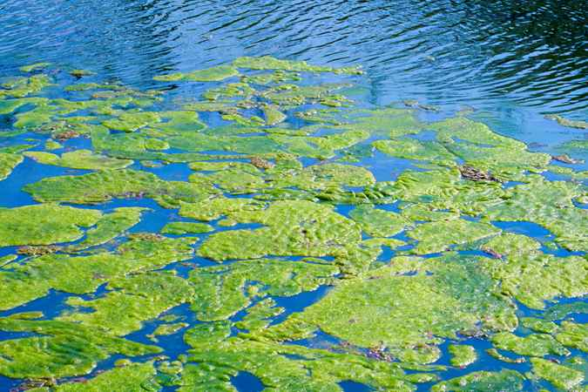
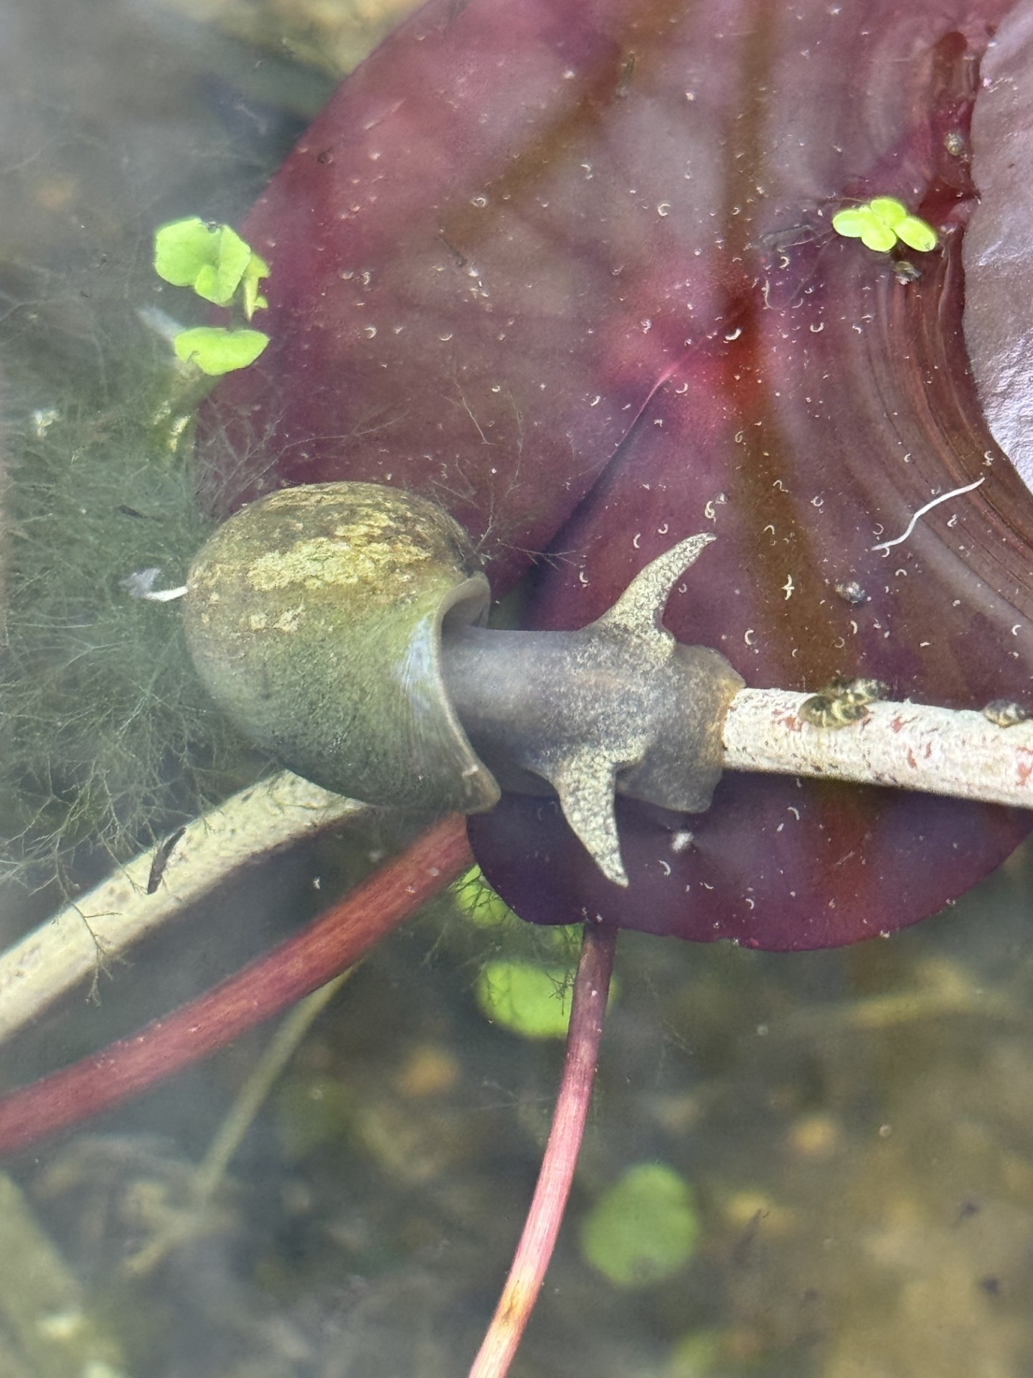
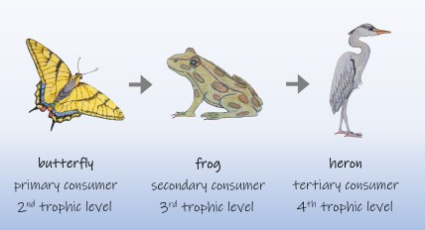
Food Chain
The biological components of a pond ecosystem include all living organisms, which are categorized into 3 groups:
Producers -a plant that makes its own food from sunlight.
Consumers -a consumer that eats the producer.
Decomposers- organisms that break down dead organisms

Slide 4
Method
First we made the pond by levelling the ground, building the man made pond and then filling it with water.
We then added sand and gravel, and used pebbles to make a beach area with different heights so the animals can get in and out easily. The pond also has steps to get in and out of.
Next we researched which plants would best suit our pond and the type of animals we wanted to attract. We planted some plants that not only added shade, but also help to oxygenators the water and filter out pollutants and give a place for the creatures to lay their eggs.
We also put plants and shelters around the outside of the pond to shelter and protect the animals from predators and the sun. I made the shelters using a 3D printer.
We also planted wild flower seeds and scented flowers to attract other wildlife.

Slide 5
Data Collection
Primary Data Collection:
Primary data was collected using field research techniques and observations.
Observations were completed for an hour during the morning and after dusk to enable a fair recording of species.
Observations were recorded over a month period to allow species to establish in the new pond.
Each species that was observed was photographed to enable correct identification using internet resources and Google lens.
The type and number of species were then recorded down.

Slide 6

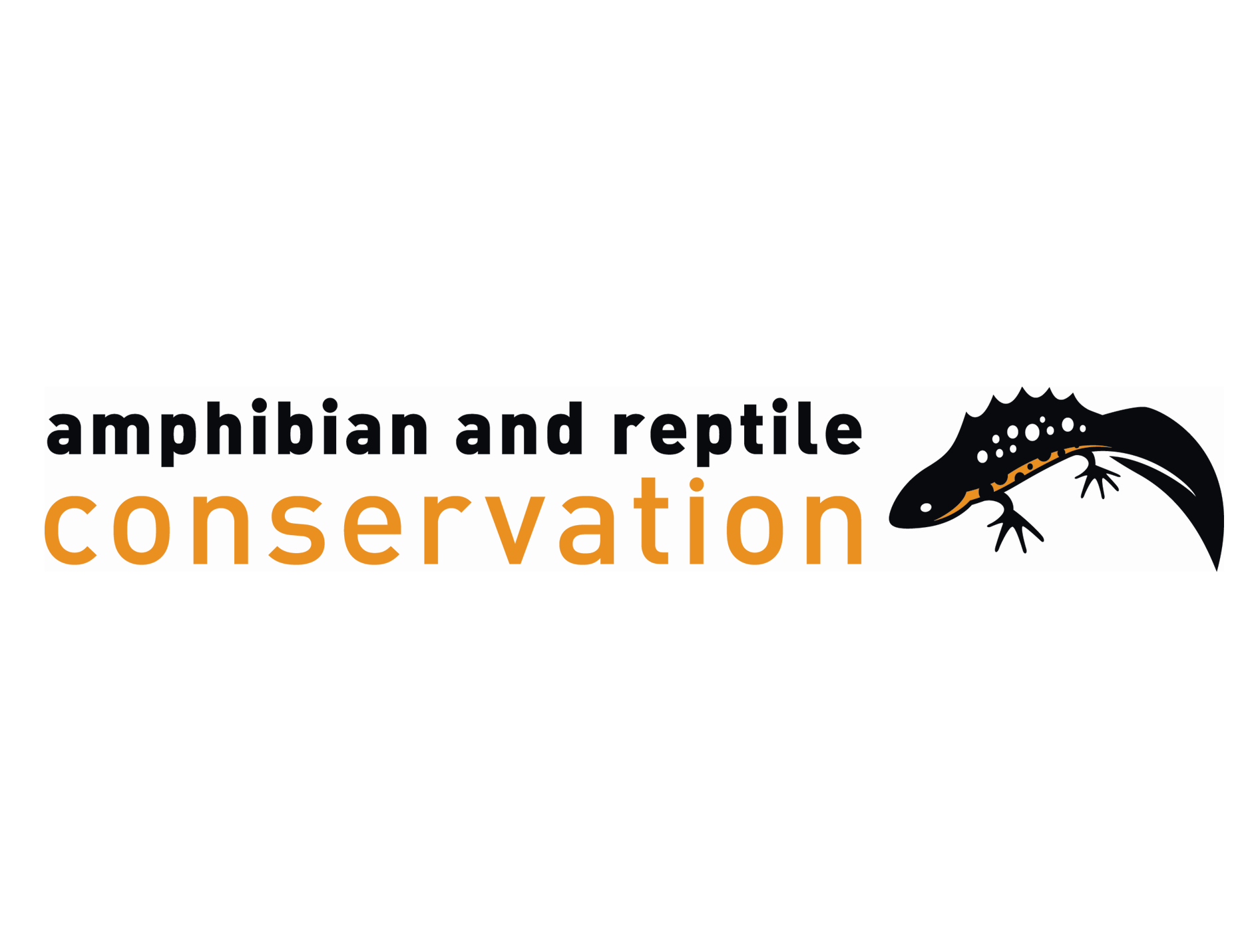

Identifying species
I used numerous different online resources to help identify the different species that I observed in the pond.
Example of online sources used:
The wildlife trust
Amphibian and reptile conservation trust
British dragonfly society

Slide 7
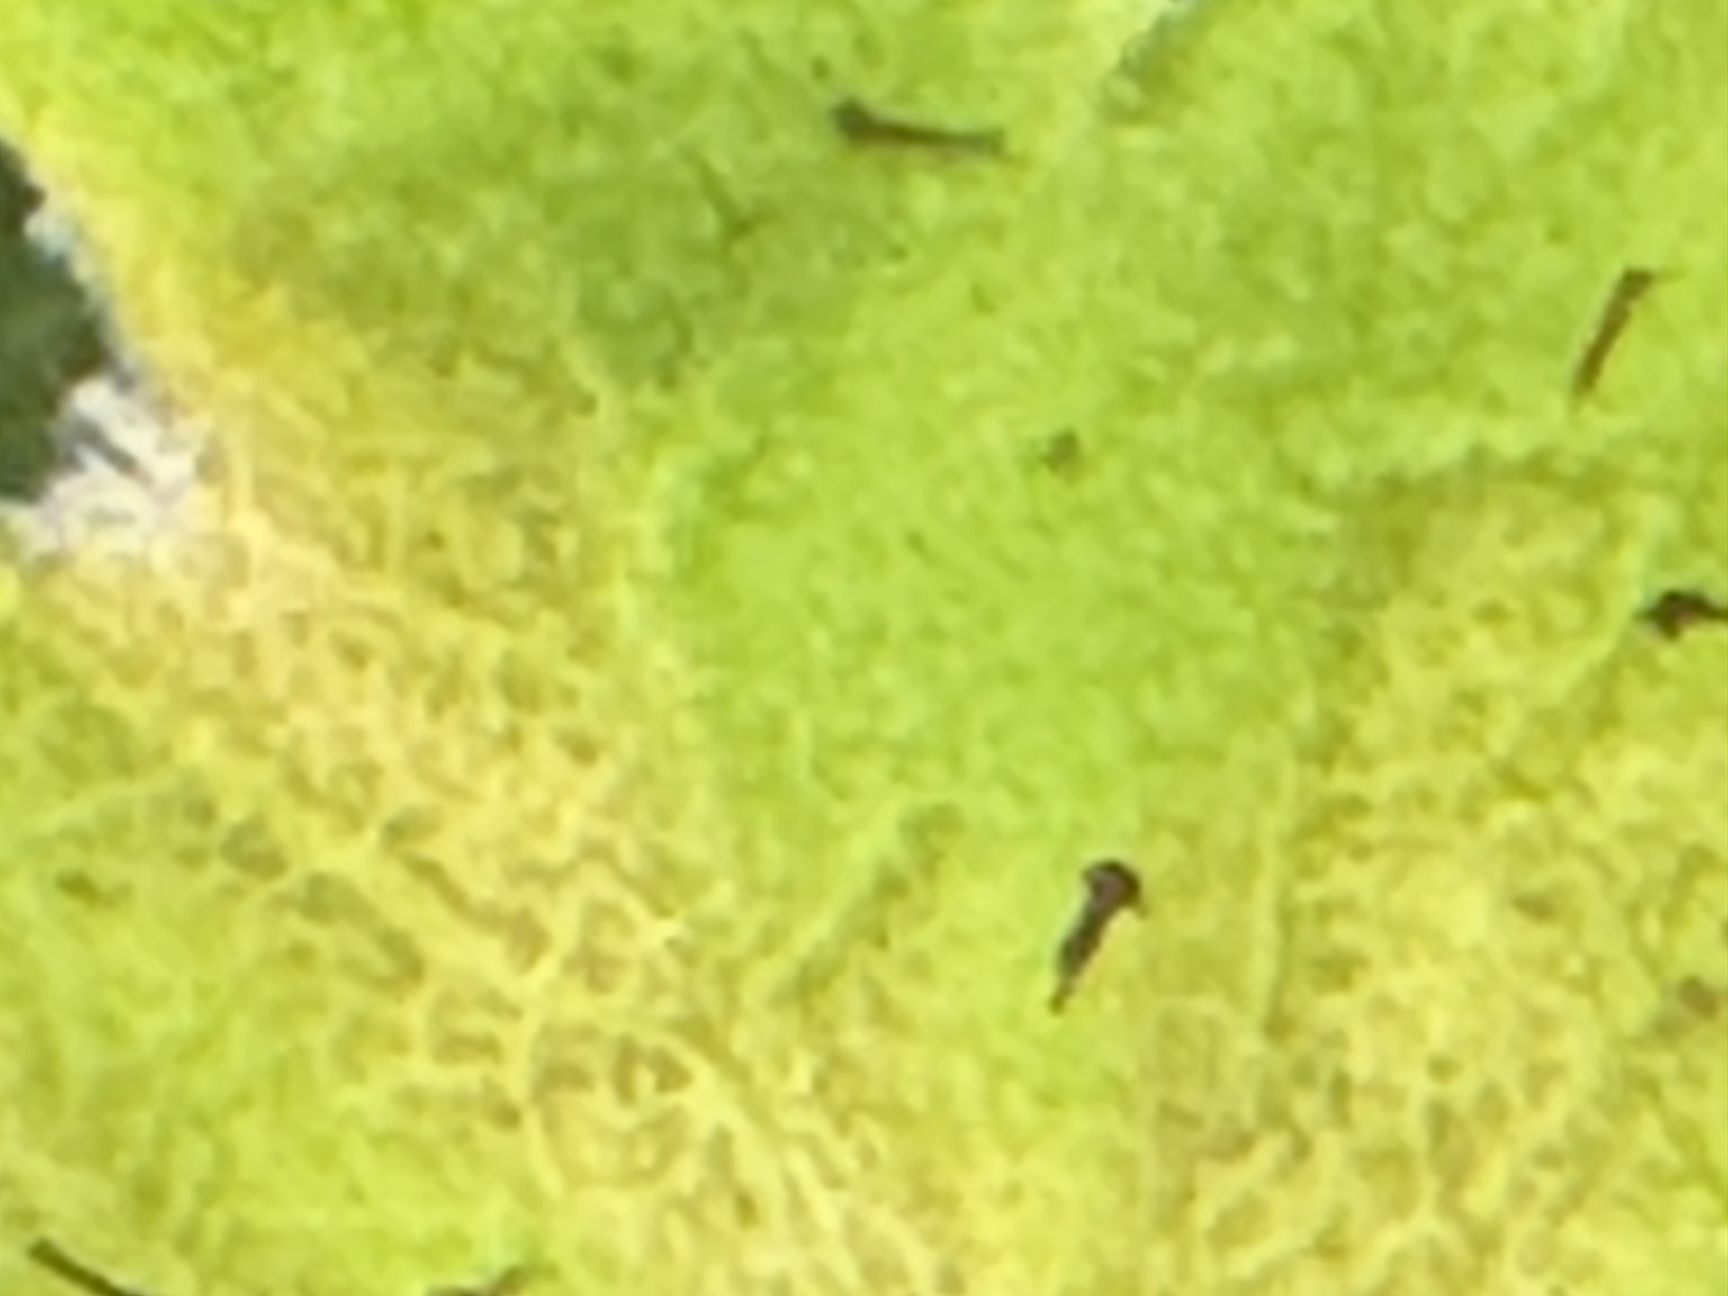
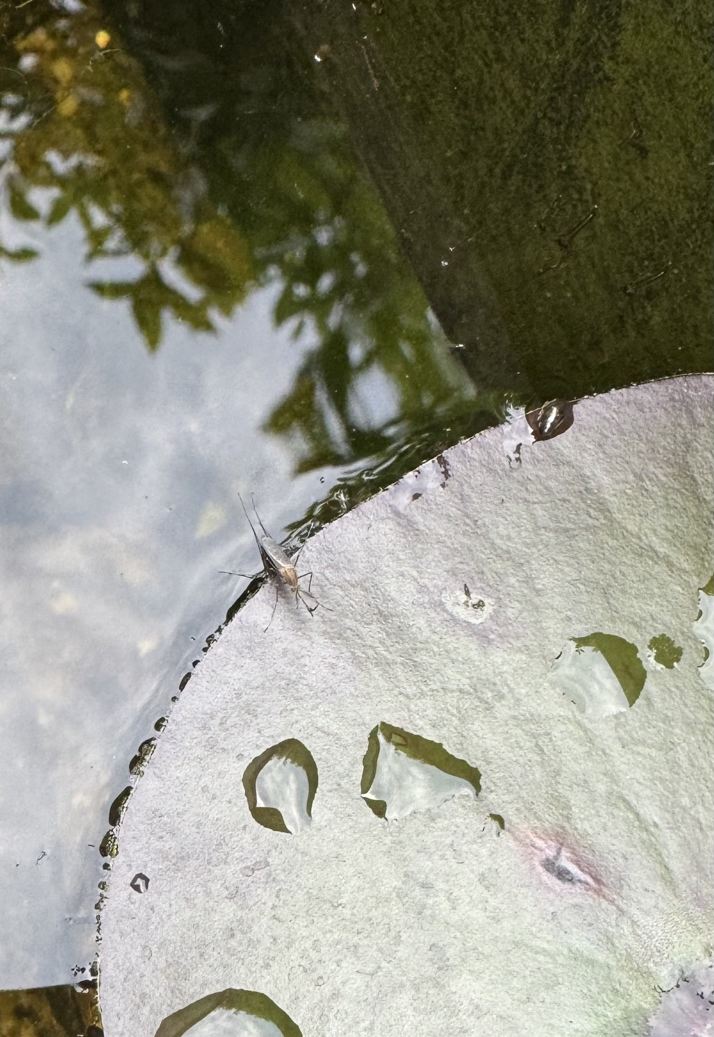
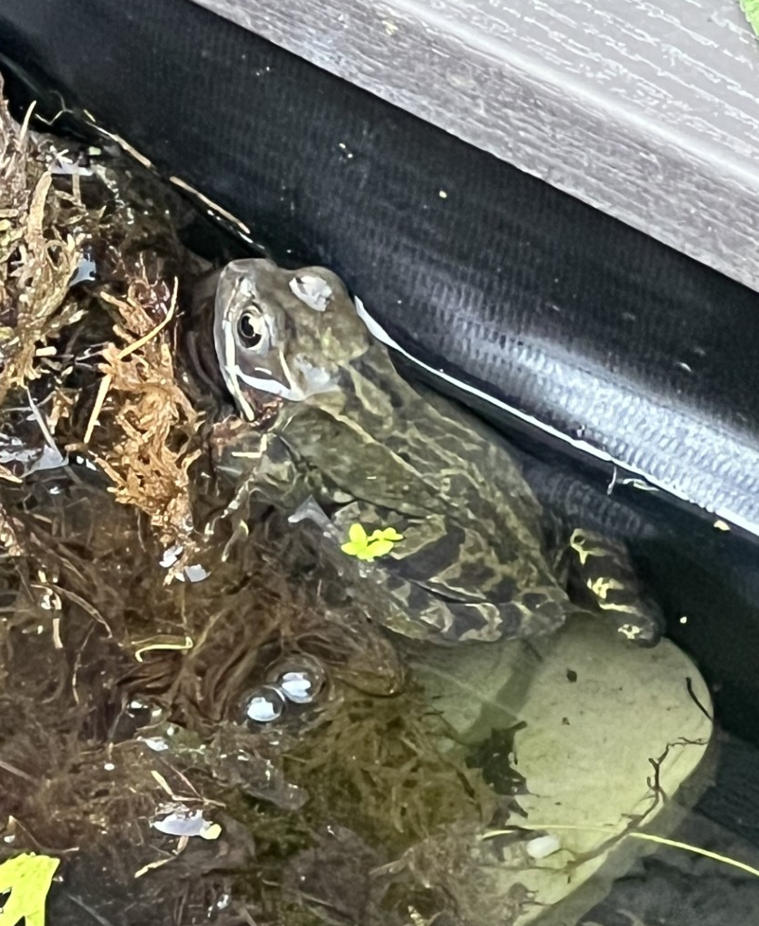
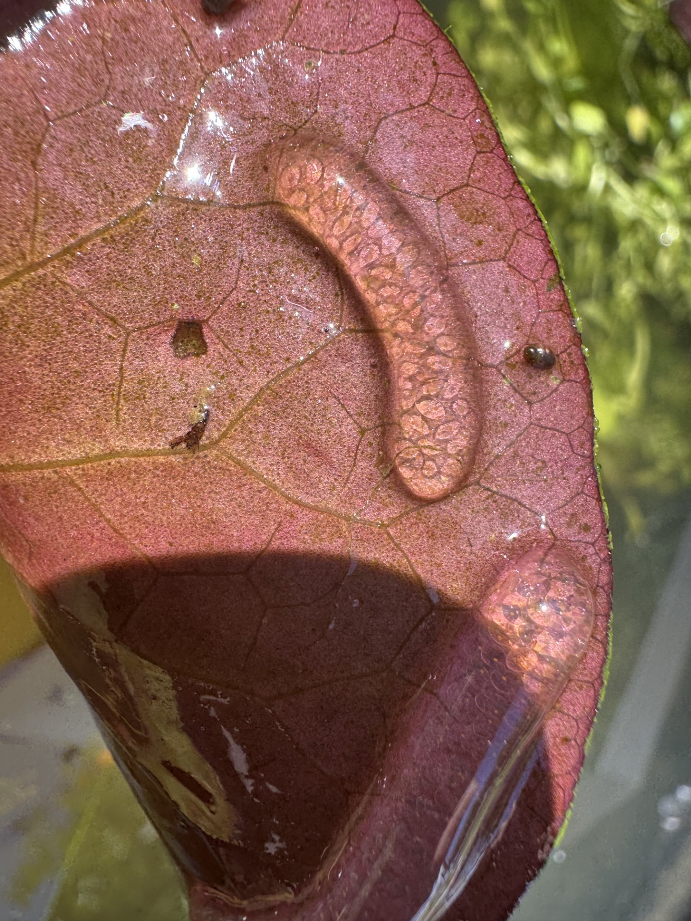
Photographs:
Mosquito & larvae
Common toad
Great pond snail and eggs
The photos show the different species in my pond. We first added some plants, algae, and two great pond snails to the pond. These acted as the producers for the ecosystem. The mosquito larvae and the snail eggs came next and they were the primary consumers in the pond. We then had a Common toad come to the pond which fed off of the primary consumers. We also have tadpoles in our pond.

Slide 8
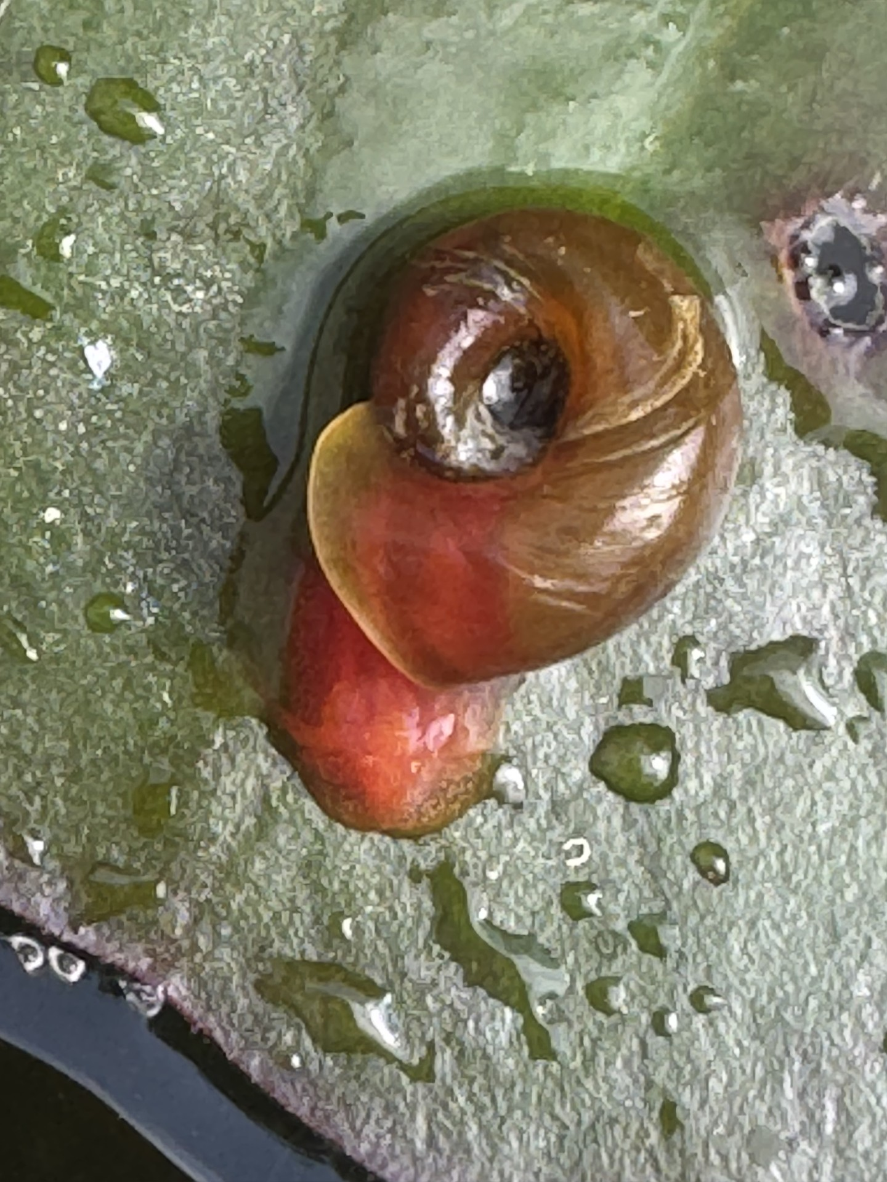
Pond Snails
Great pond snail and eggs​
Ramshorn snail

Slide 9
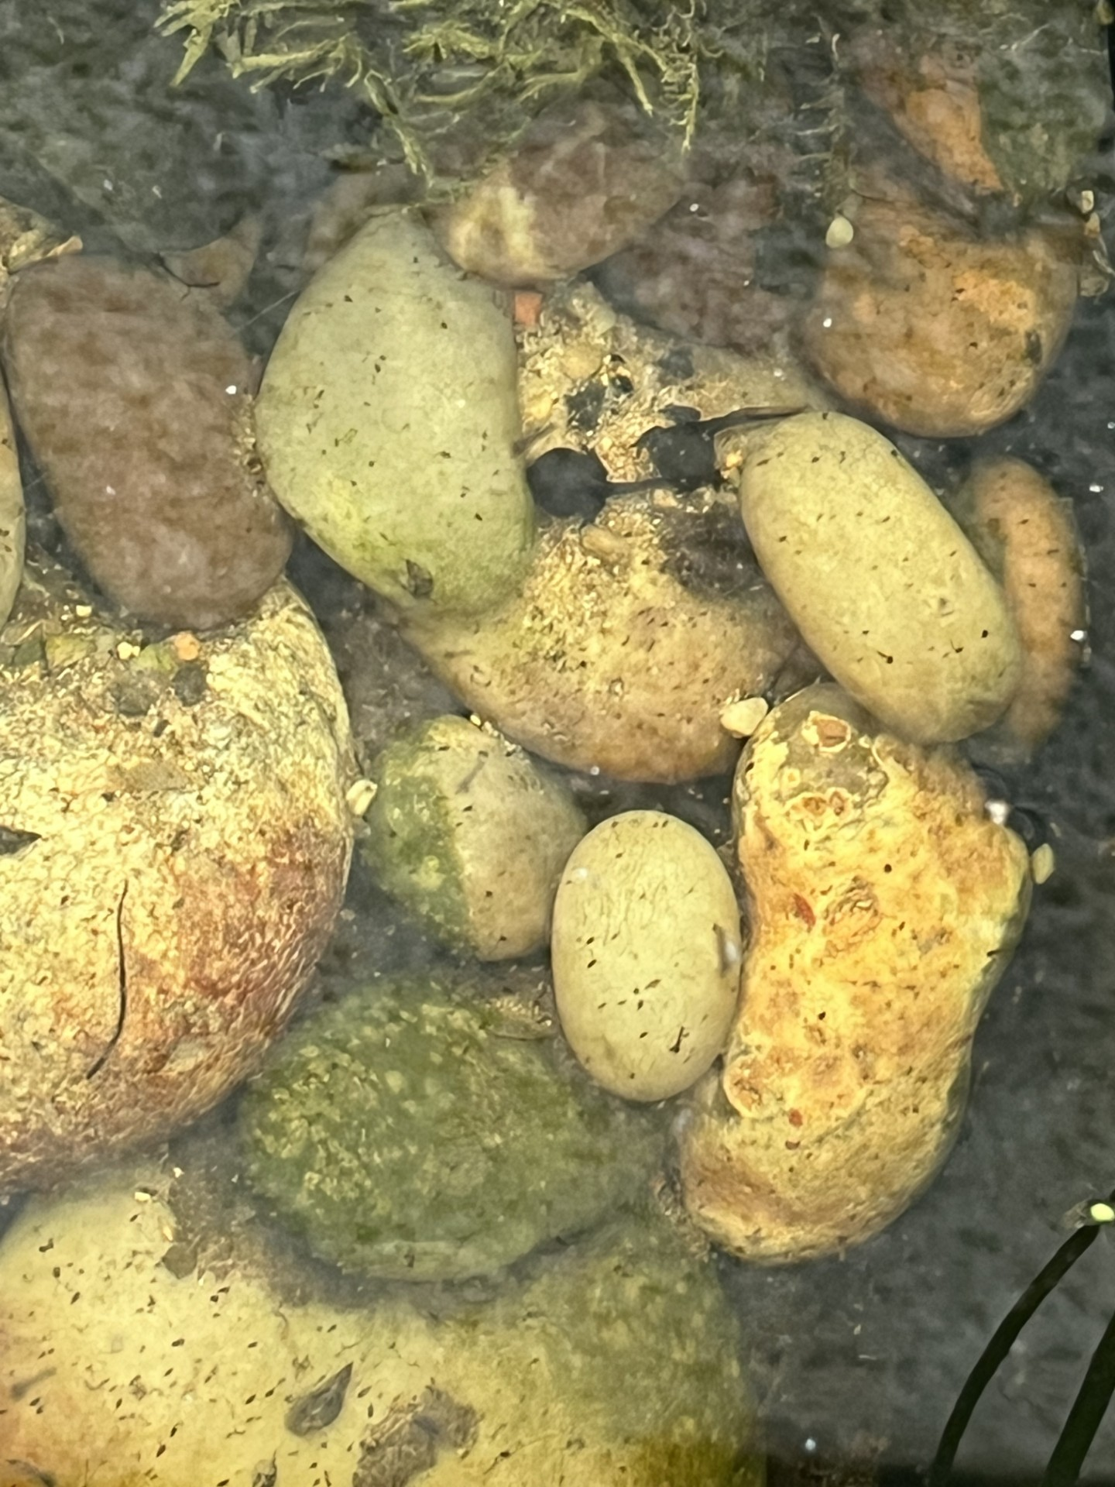
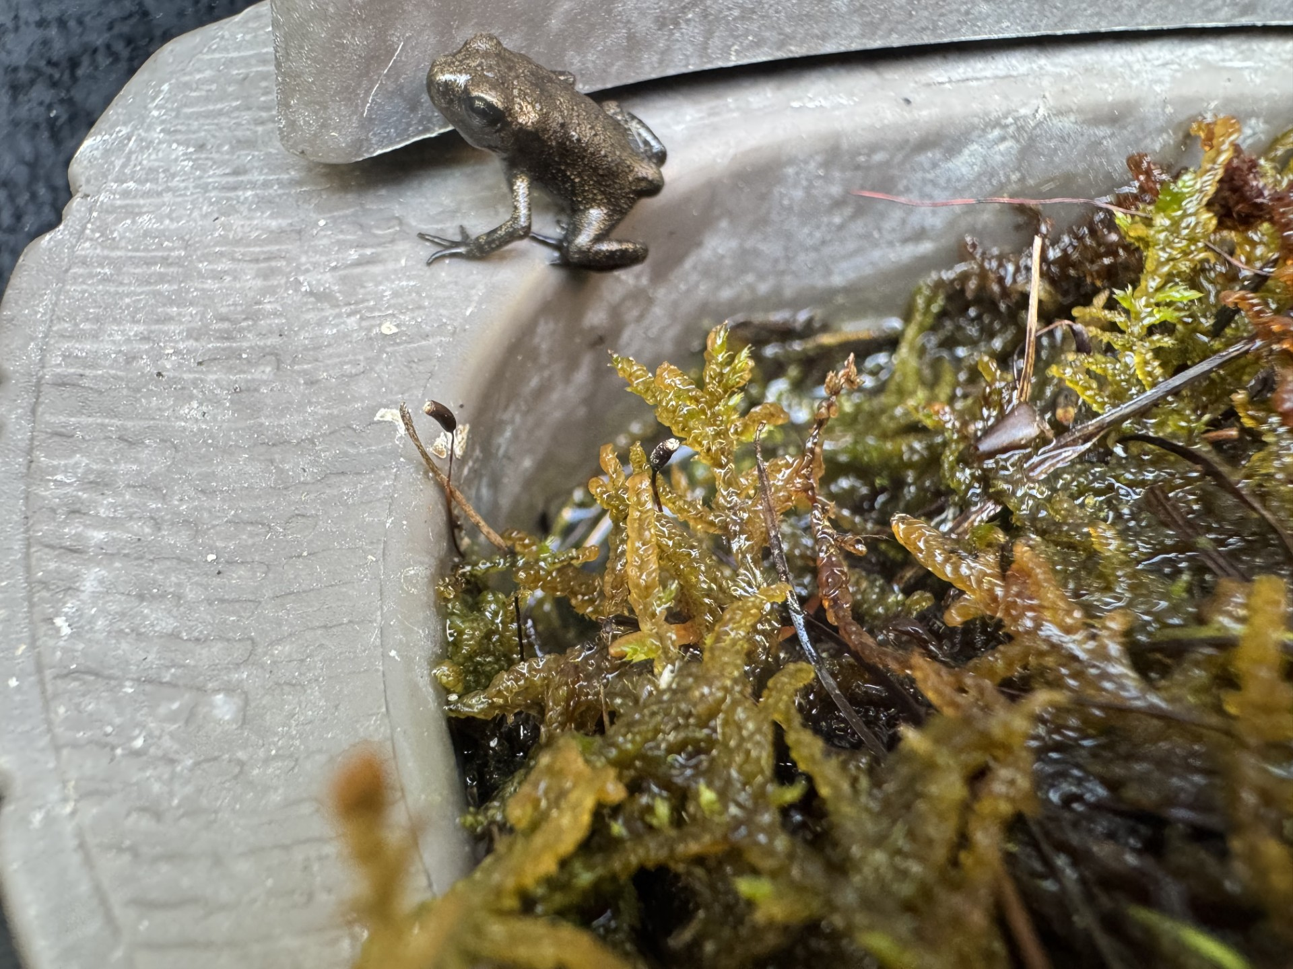
Tadpoles, toads and frog

Slide 10
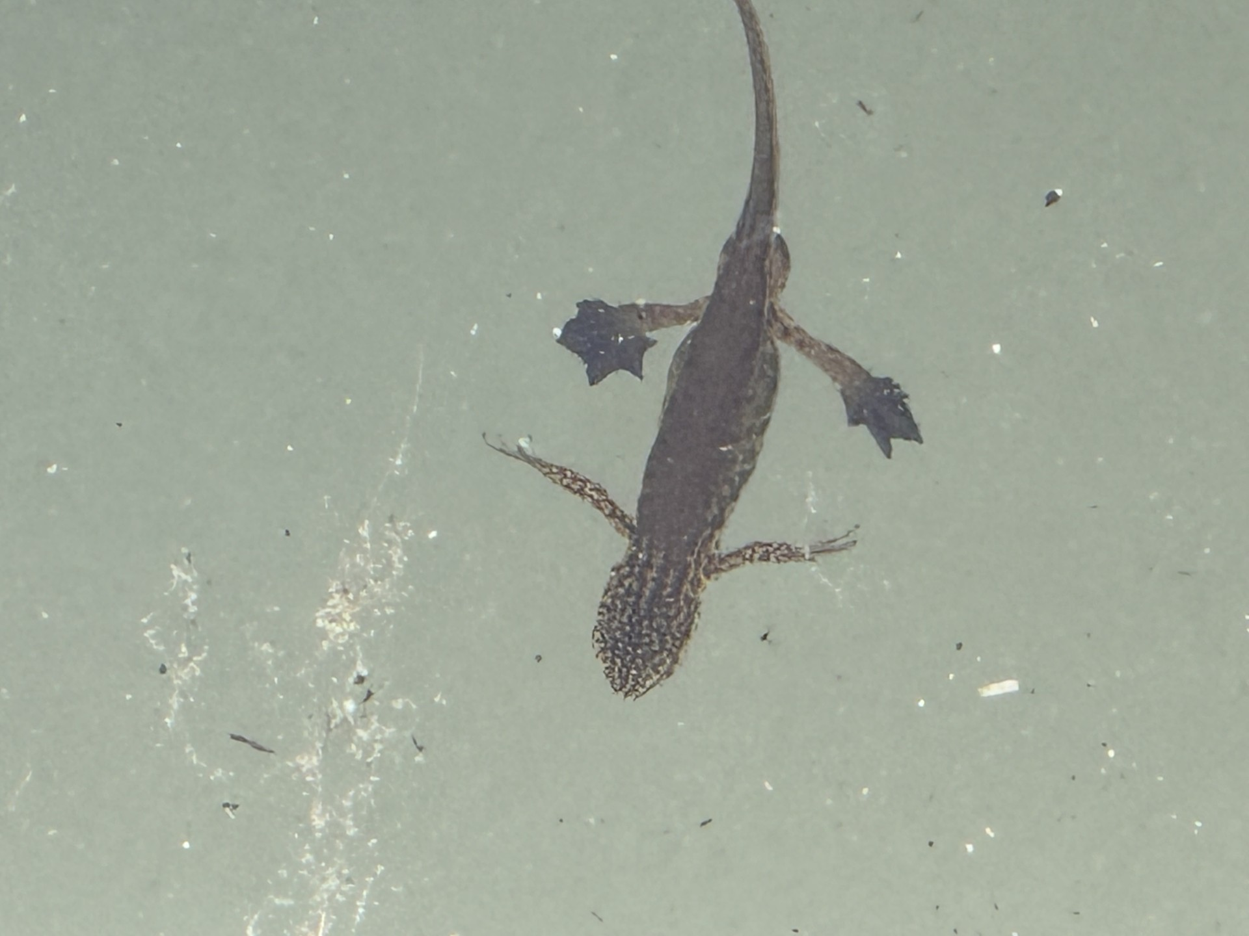
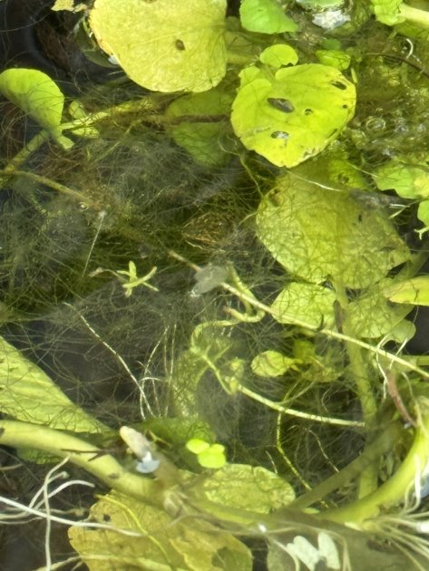
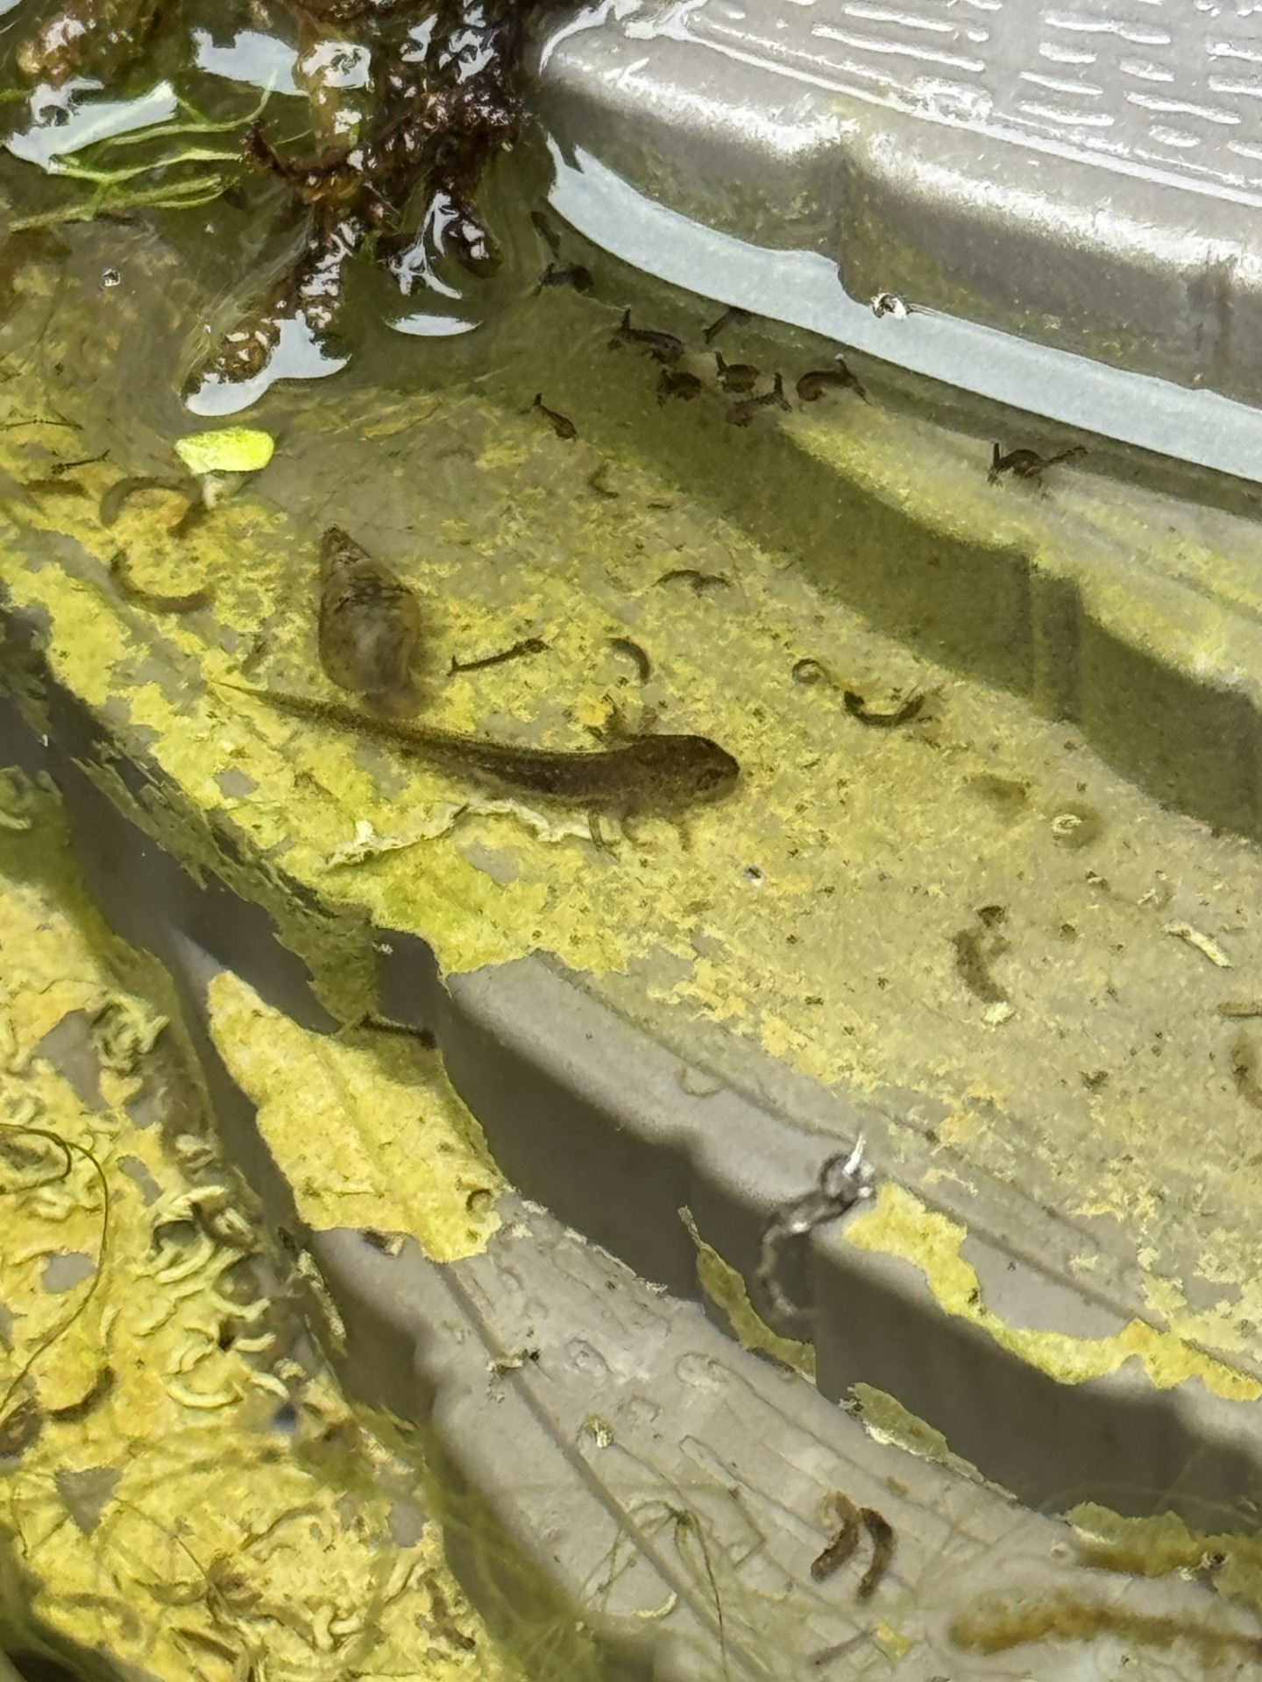
Palmate newt and baby newt (EFT)

Slide 11
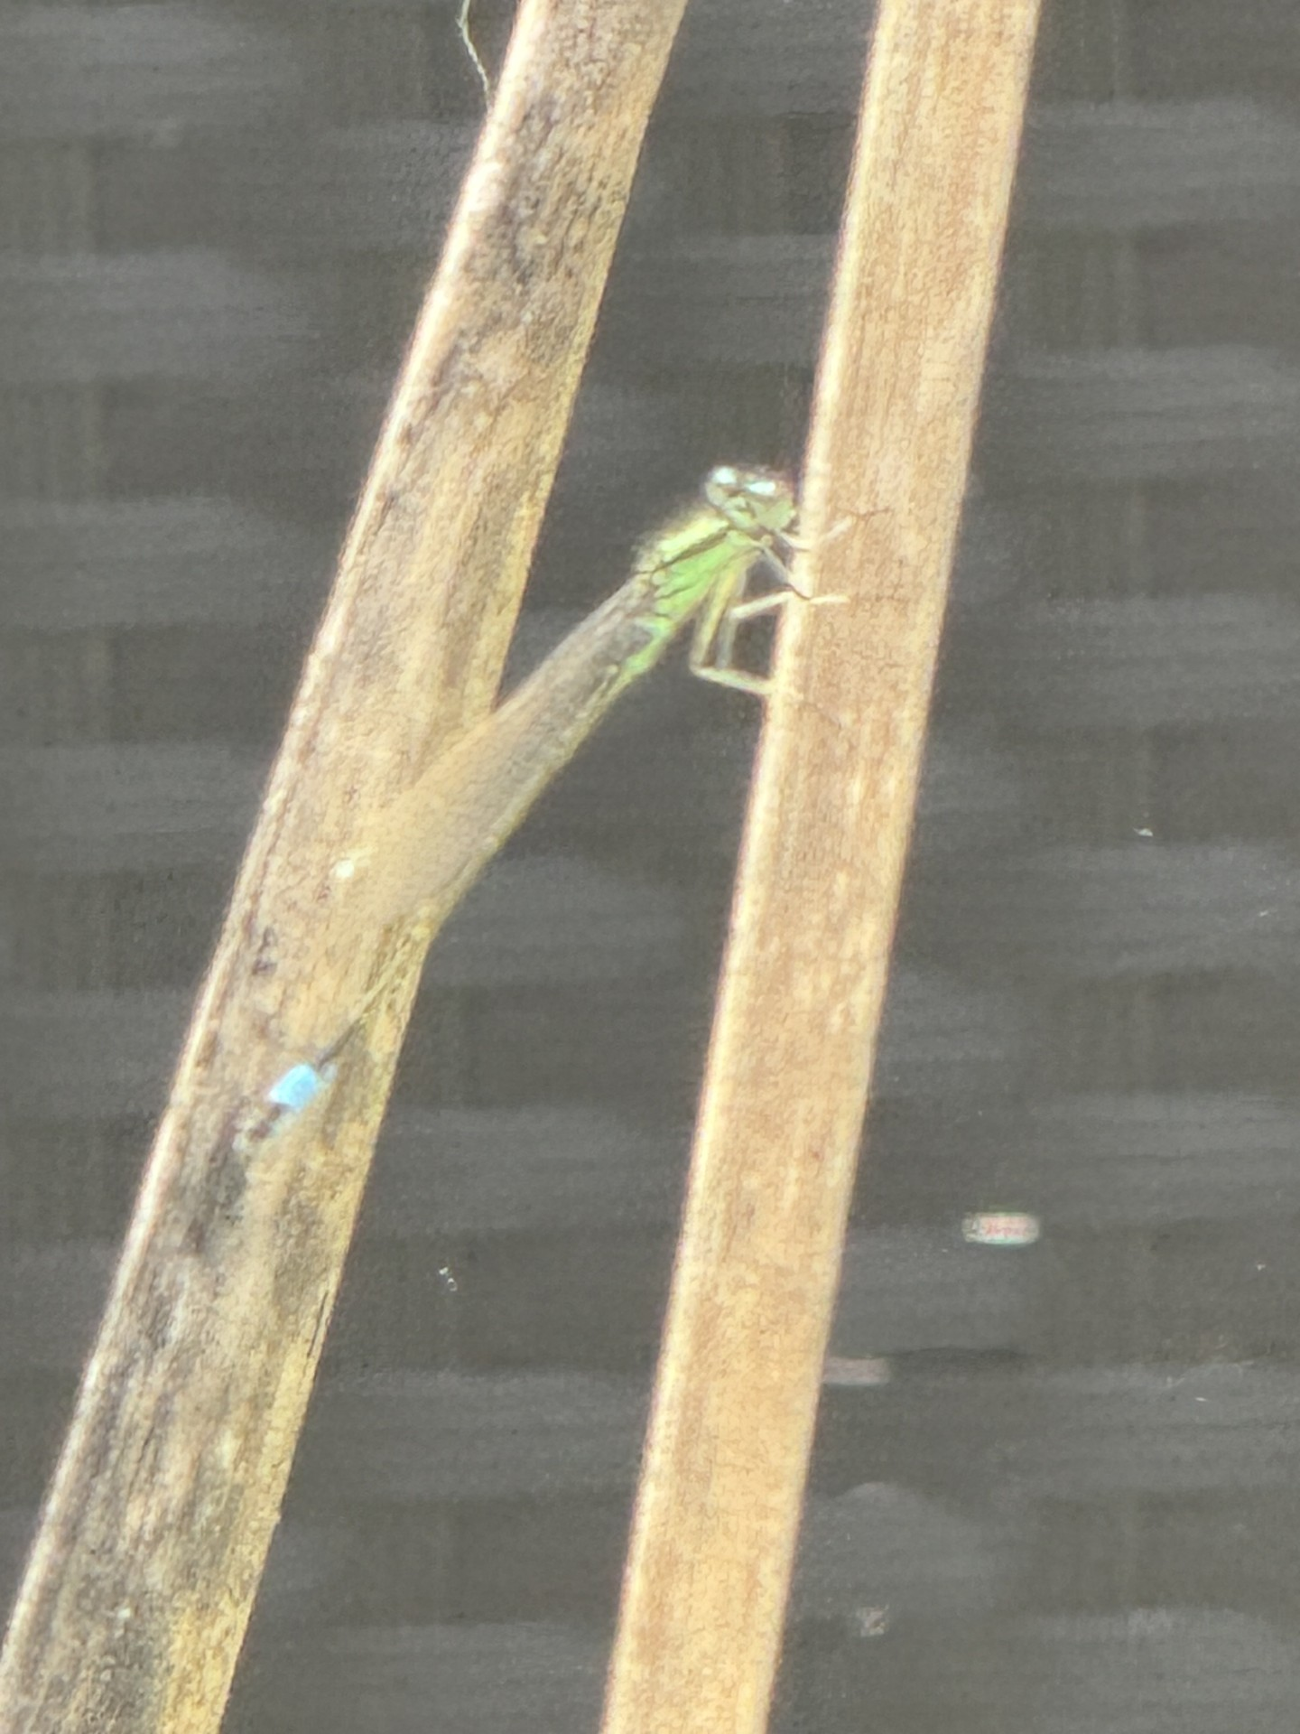
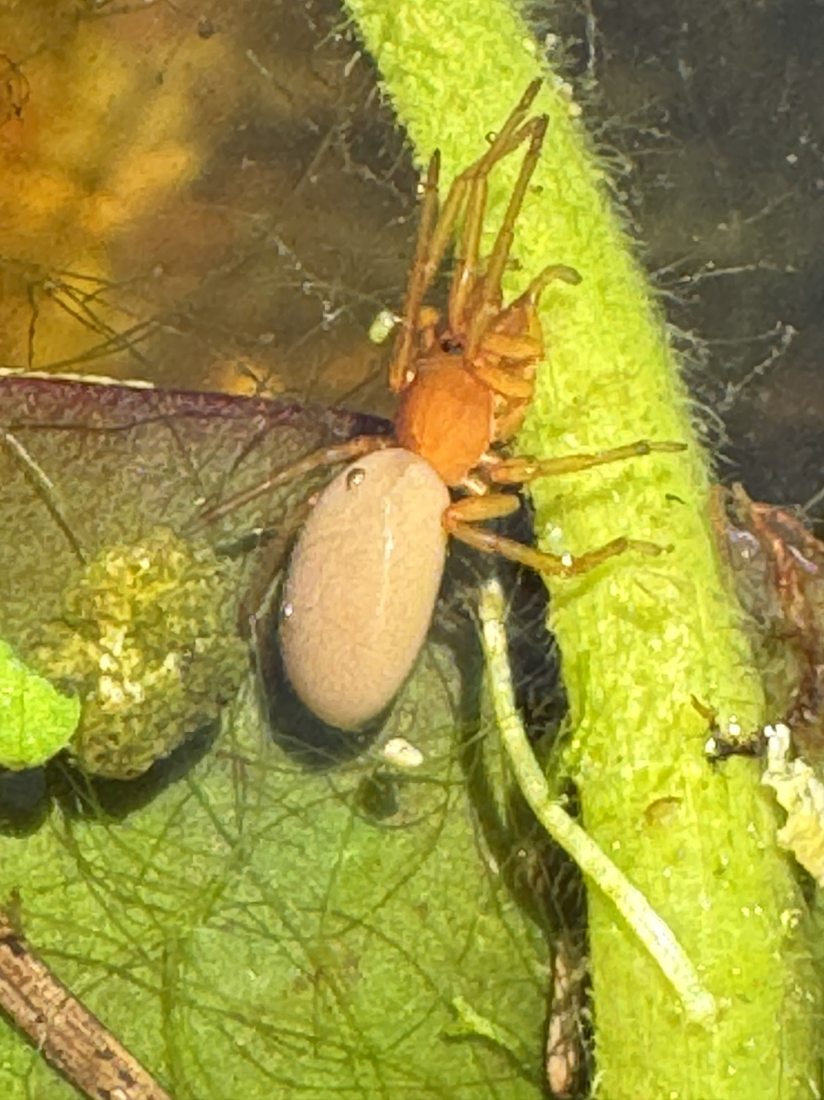
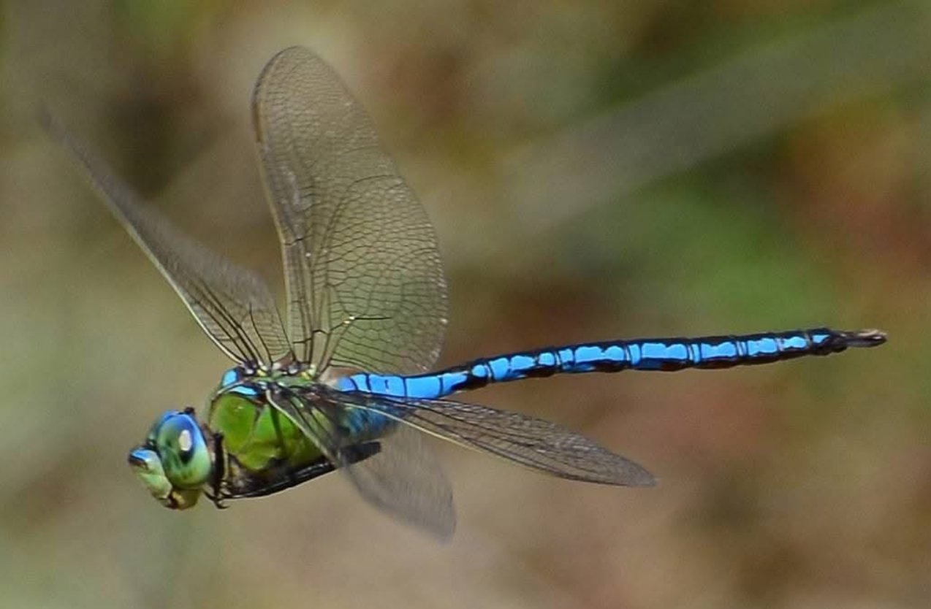
Damsel fly, Emperor dragonfly and Woodlouse eating spider

Slide 12
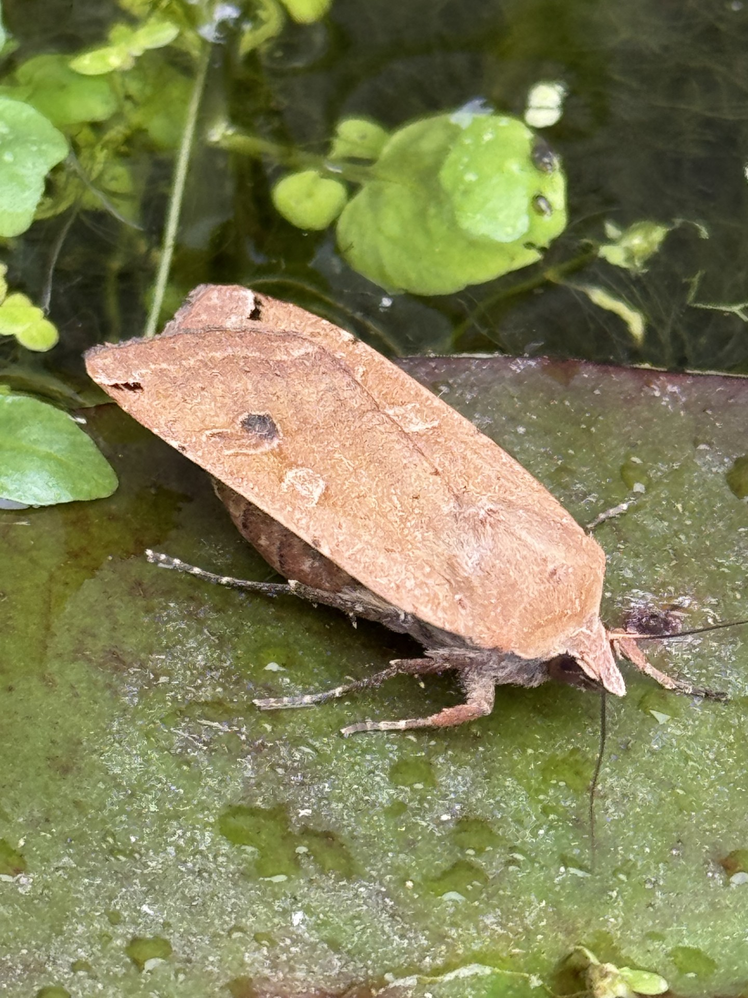
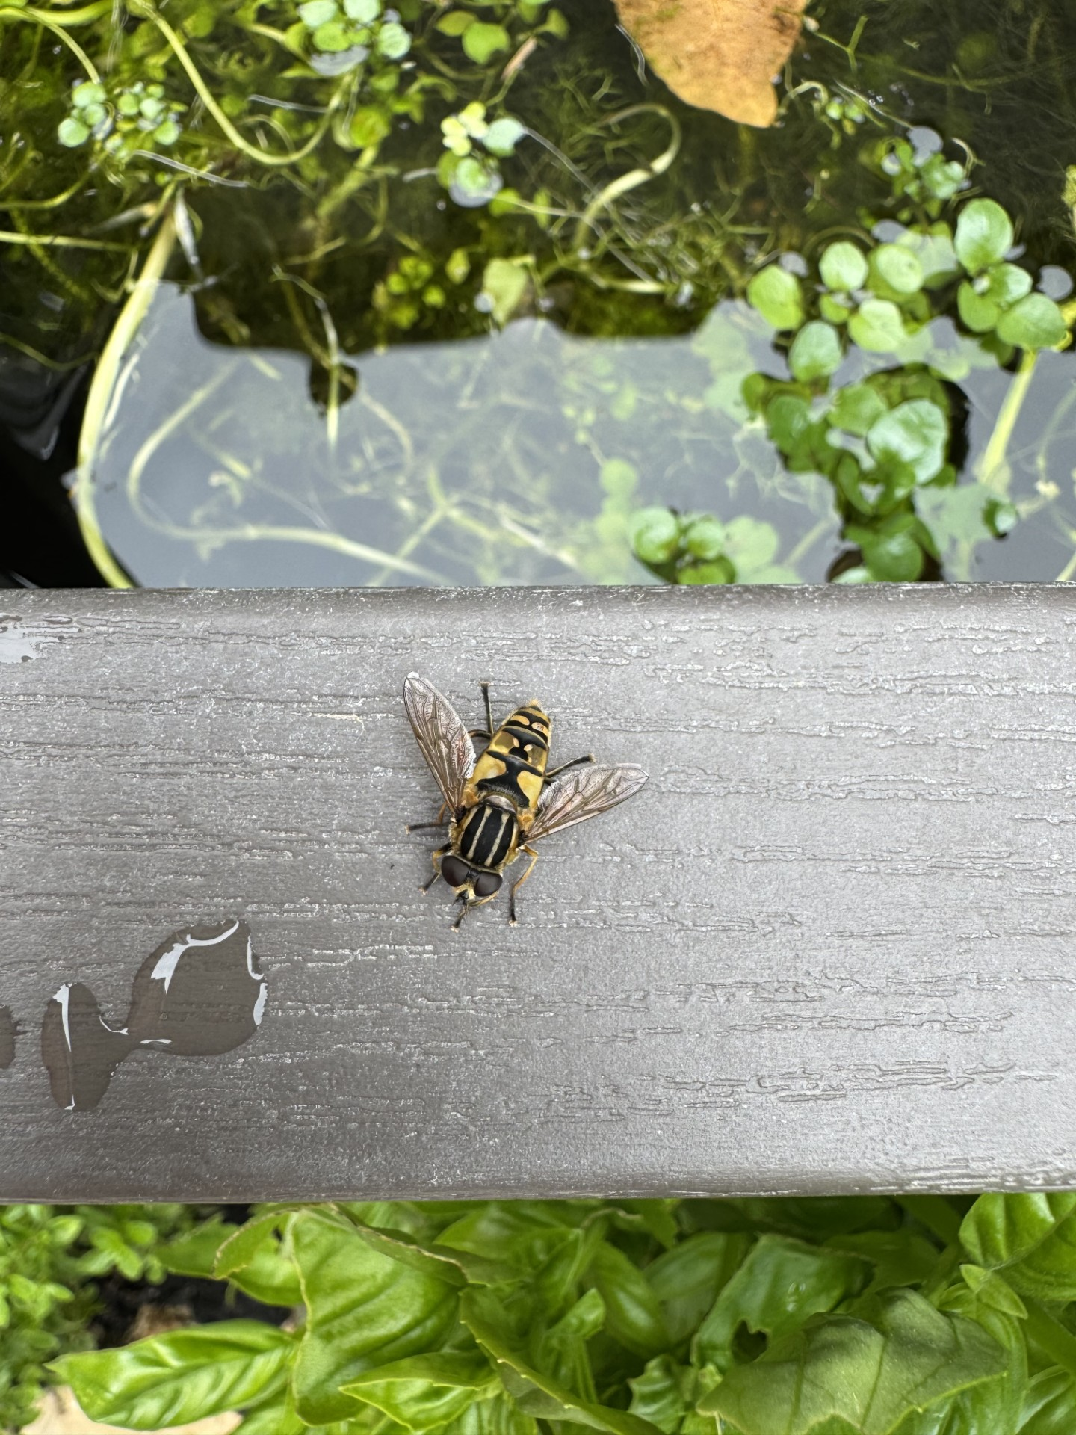
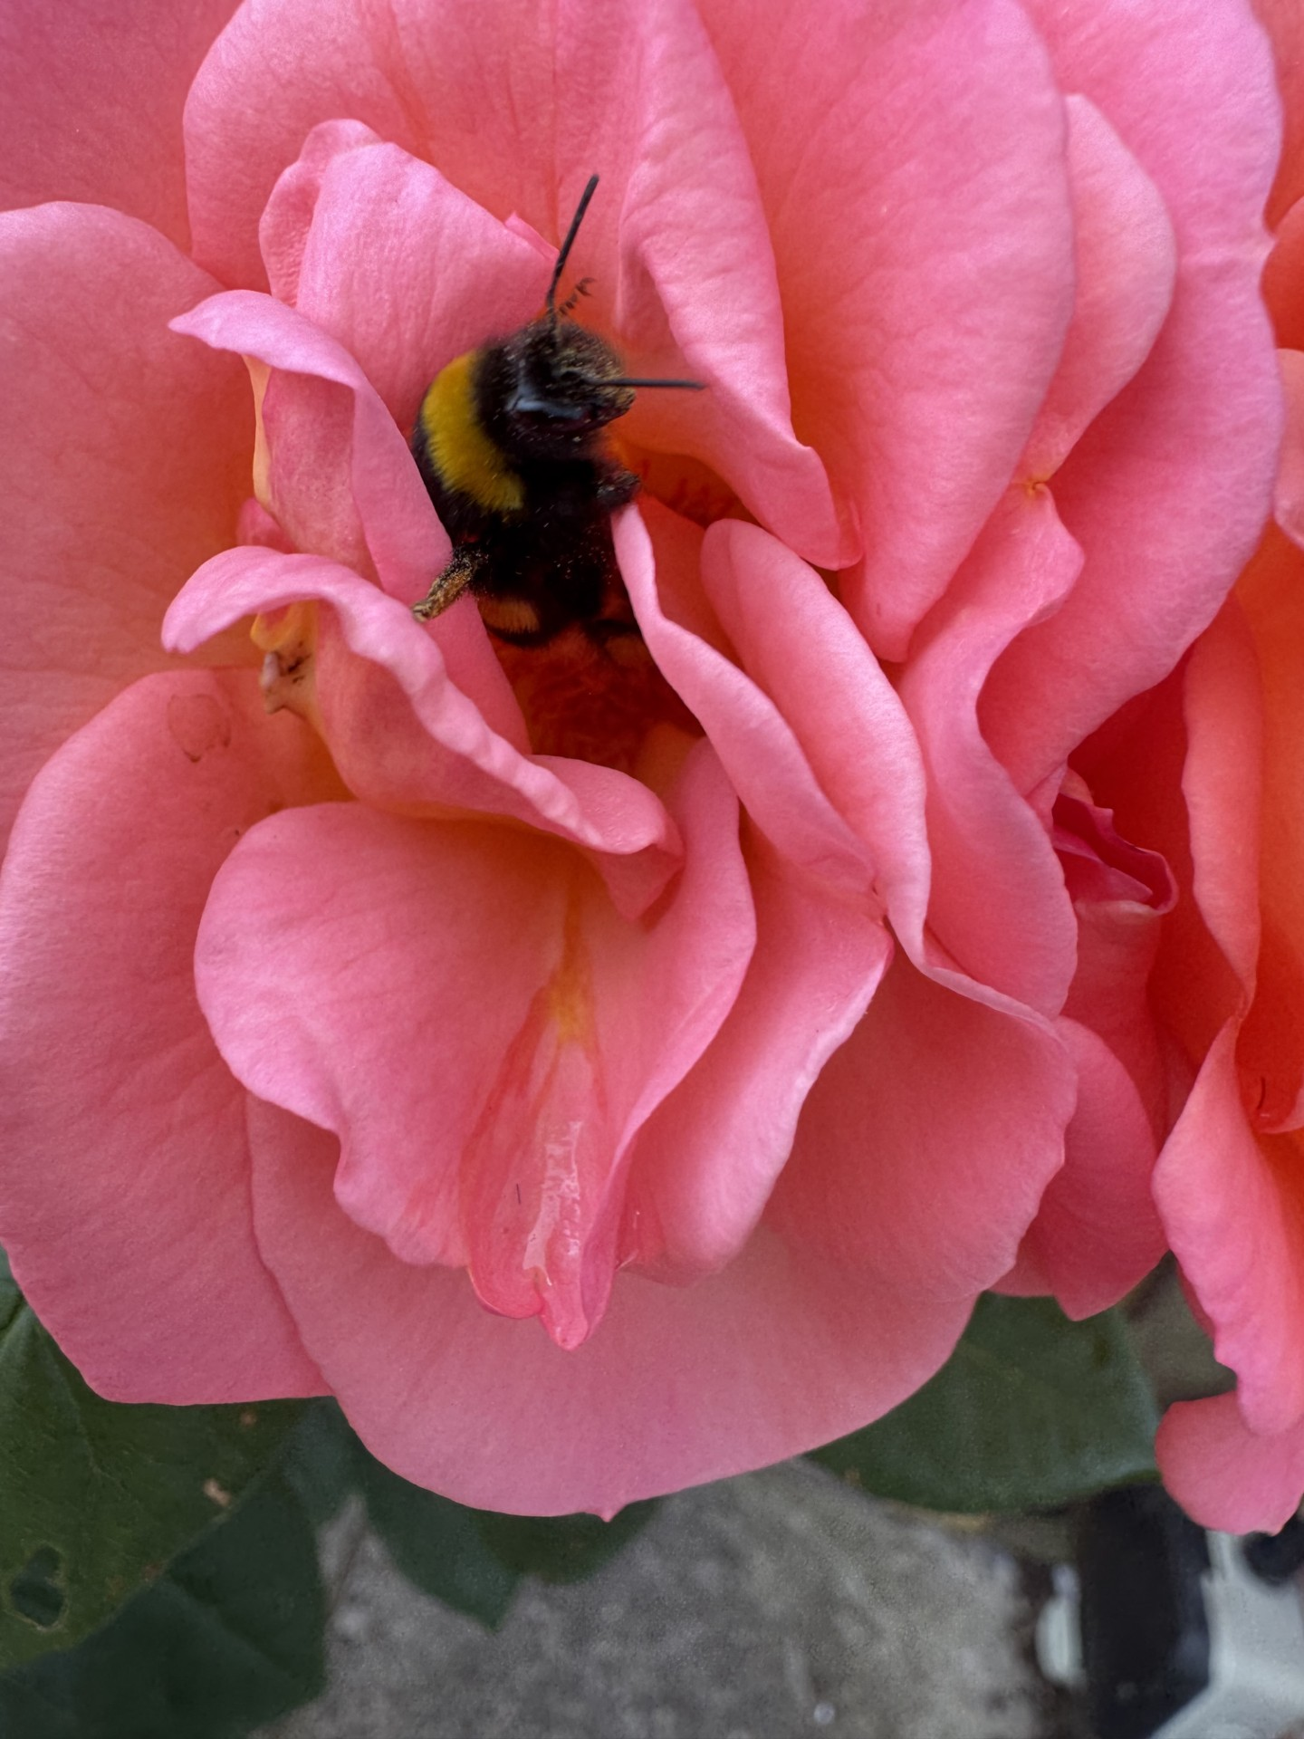
Bumblebee, Large yellow underwing and hover bee

Slide 13
Results
Animals | Amount
large yellow underwing | 1
Common toad | 5
Tadpoles | 22
Field Grasshopper | 2
Bumble bee | 1
Woodlouse spider | 2
Common frog | 1
Emperor dragon fly | 1
Great pond snail | 17
Palmate newt | 5
Eft | 1
blue tailed damsel fly | 1
Water strider | 2
Blood worms | 30
Pink Ramshorn snail | 2
Sawfly larvae | 2
Hoverfly | 3
Great pond snail eggs | 50
Mosquito Larvae | 60
The results show that the most common animals are the Mosquito and midge larvae (bloodworms) and the Great pond snail eggs.
They also show that more larger animals like the common toad and common frog which were adults are much fewer in numbers.

Slide 14
Bar chart showing the different species and numbers observed in the pond
The bar chart shows that each biological component needed to create a pond ecosystem were identified in the pond, there were producers, primary and secondary consumers and decomposers. ​

Slide 15
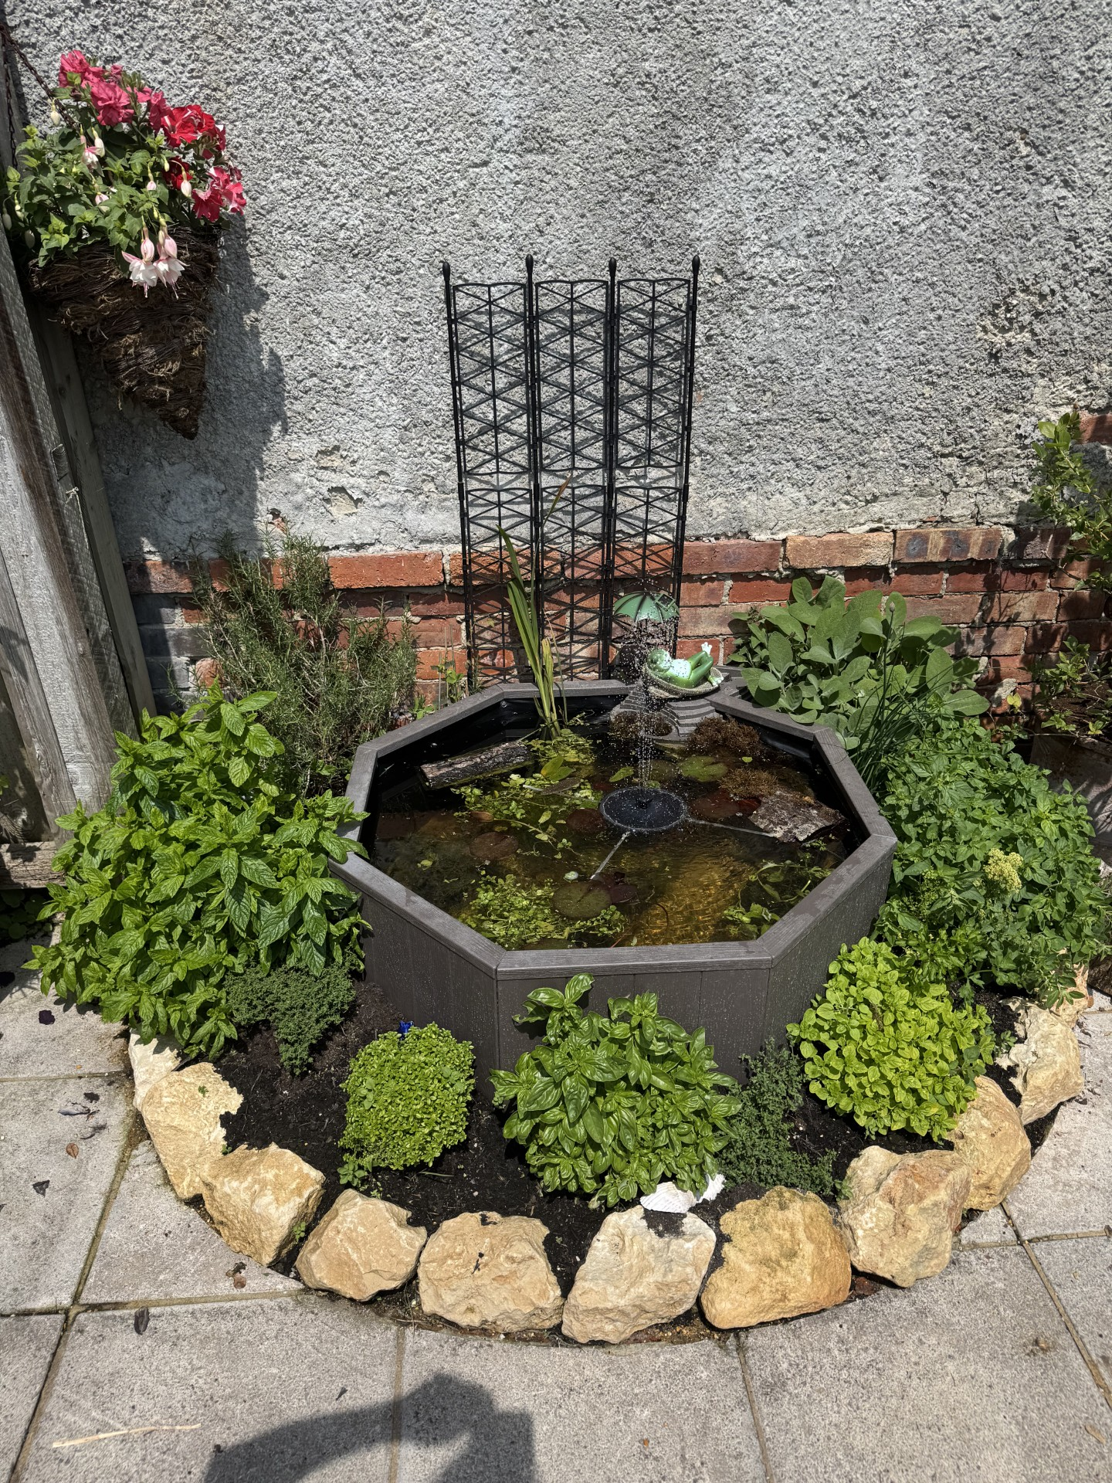
Conclusion
My Conclusion is that a man-made wildlife habitat can provide an Ecosystem for reptiles, amphibians and other wildlife to live in. The recorded field observations show that the amount of wildlife around the pond has increased with at least 15 new species observed.

