Slide 1
Positive lists
Louis Kenway

Slide 2
What is a positive list?
List of animals suitable to keep as pets
All animals not on the list would be prohibited as pets
This is a simple way of making clear guidelines for pet owners and the pet trade
It would be the same for every country in Europe

Slide 3
How would it work?
It would be based on scientific evidence
The list could be updated at any time

Slide 4
What are the benefits?
Animal Welfare
Public health and safety
Protects the environment (from risks of catching banned animals and if they escaped)
Creates one simple system for Europe

Slide 5
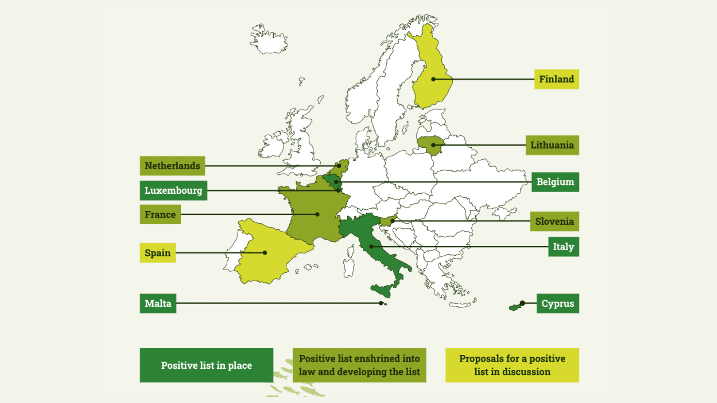
Some are already working on these lists
Source – europgroupforanimals.org

Slide 6
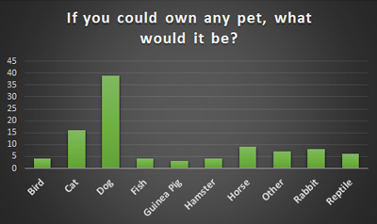
Let’s hope these pets make it on the list
Top 10 pets children would like to own
Source – educationquizzes.com

Slide 7
Any questions?

